Slide 1
The Evolution of Proofs in Computer Science: Succinct Zero-Knowledge Proofs
6.857
Lecture 13

Slide 2
Last Lecture: BitCoin Protocol
Public
Ledger
Each user has to verify the validity of each payment in a block before adding the block to the public ledger
This check is highly inefficient: It requires going over the entire public ledger!

Slide 3
Last Lecture: BitCoin Protocol
Public
Ledger
zero-knowledge
A succinct proof that my transaction is valid!
Notes:
As mentioned anyone should be able to come and verify the proofs- whenever they want, without interacting.

Slide 4
The Evolution of Proofs in Computer Science
which leads to succinct zero-knowledge proofs

Slide 5
Classical Proofs
$$P$$
$$V$$

Slide 6
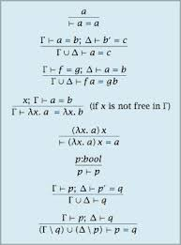
Classical Proofs
$$P$$
$$V$$
Conjecture: $∃$succinct classical proof for correctness of any computation $M\left(x\right)=1$ within $T$steps

Slide 7
Zero-Knowledge Proofs [Goldwasser-Micali-Rackoff85]
Proofs that reveal no information beyond the validity of the statement

Slide 8
Zero-Knowledge Proofs [Goldwasser-Micali-Rackoff85]
Impossible!
This is information!

Slide 9
Interactive Proofs [Goldwasser-Micali-Rackoff85]
$$P$$
$$V$$
Completeness$: ∀x∈L \operatorname{Pr}\left[\left(P,V\right)\left(x\right)=1\right]≥2/3$
Soundness: $∀x∉L, ∀P^{∗} \operatorname{Pr}\left[\left(P^{∗},V\right)\left(x\right)=1\right]≤1/3$
Note: By repetition, we can get completeness $1−2^{−k},$and soundness $2^{−k}$

Slide 10
Interactive Proofs [Goldwasser-Micali-Rackoff85]
For ZK the prover needs to be randomized
$$P$$
$$V$$
[Goldreich-Micali-Wigderson87]: Every statement that has a classical proof has zero-knowledge (ZK) interactive proof, assuming one-way functions exist
Notes:
To obtain ZK the prover needs to be randomized too. Randomness is used to hide secret information.

Slide 11
Defining Zero-Knowledge
This transcript reveals no information
$$x∈L$$
$$P$$
$$V$$
Formally: There exists a $PPT$algorithm $S$ (called a simulator), such that for every $x∈L:$
$$S\left(x\right)≈(P,V)(x)$$
Denotes the transcript

Slide 12
ZK Proofs for NP
Graphs for which vertices can be colored by {1,2,3} s.t. no two adjacent vertices are colored by the same color
For the $NP$-complete language of all 3-colorable graphs
$$G=\left(V,E\right)$$
Locked safe, reveals no information about its content
$$P$$
$$V$$
$C_{1}$
$C_{n}$
Randomly permute the coloring, to obtain valid coloring $(c_{1},…,c_{n})$
Choose a random edge $\left(i,j\right)∈E$
$$\left(i,j\right)∈E$$
Open safes $i,j$
Soundness: Only $1−\frac{1}{\left|E\right|}$but can be amplified via repetition.
Notes:
A graph is 3-colorable if there is a coloring of al the nodes using only three colors such that no two adjacent nodes are colored using the same color.

Slide 13
ZK Proofs for NP
For the $NP$-complete language of all 3-colorable graphs
$$S\left(V,E\right):$$
Choose a random $\left(i,j\right)∈E$
Choose random distinct colors $c_{i},c_{j}$
The simulated transcript is:
$$G=\left(V,E\right)$$
$$P$$
$$V$$
safes $i, j$have values $c_{i}, c_{j}$
$C_{1}$
$C_{n}$
$$\left(i,j\right)∈E$$
$$\left(i,j\right)∈E$$
Open safes $i,j$
Open safes $i,j$
Notes:
ZK proof for any NP complete language implies ZK proof for all of NP, via NP reduction.

Slide 14
Implementing Digital Safes: Commitment Scheme
A commitment scheme is a randomized algorithm $Com$ s.t.:
Hiding:$∀m,m^{′}$ $Com\left(m;r\right)≈Com(m^{′};r^{′})$.
Binding: $∃\left(m,r\right), \left(m^{′},r^{′}\right)$s.t. $m≠m′$ and
$$Com\left(m;r\right)=Com(m^{′};r^{′})$$
Notes:
We have mentioned this notion early on when we talked about one-way functions and collision resistant hash functions, and their applications.

Slide 15
Using Commitments to Construct ZK Proofs
For the $NP$-complete language of all 3-colorable graphs
$$G=\left(V,E\right)$$
$$P$$
$$V$$
Randomly permute the coloring, to obtain valid coloring $(c_{1},…,c_{n})$
$$Com\left(c_{1}\right),…,Com(c_{n})$$
Choose a random edge $\left(i,j\right)∈E$
$$\left(i,j\right)∈E$$
Reveal $c_{i},c_{j},$with corresponding randomness

Slide 16
Constructing a Commitment Scheme
Construction 1:
Let $f:{\left\{0,1\right\}}^{∗}→{\left\{0,1\right\}}^{∗}$be an injective OWF.
$$Com\left(b;(r,s)\right)=(f\left(r\right), s,({⊕r}_{i}s_{i})⊕b)$$
Binding: Follows from the fact that $f$is injective
Hiding: Relies on the fact that if $f$is one-way then:
$$\left(f\left(r\right),s,{ ⊕r}_{i}s_{i}\right)≈\left(f\left(r\right),s\right),U)$$
Known as a hard-core predicate
[Goldreich-Levin89]

Slide 17
Constructing a Commitment Scheme
Construction 2:
Let $G$be a group of prime order p, let $g∈G$ be any generator, and $h$be a random group element.
$$Com_{g,h}\left(m,r\right)=g^{m}h^{r}$$
Hiding: Information theoretically!
Binding: Follows from the Discrete Log assumption.
If $∃PPT$alg $A$s.t.
$A\left(g,h\right)=\left(m_{1},m_{2},r_{1},r_{2}\right)$where $g^{m_{1}}h^{r_{1}}=$ $g^{m_{2}}h^{r_{2}}$then
$m_{1}+sr_{1}=m_{2}+sr_{2}$ mod p,
which implies that $s=\frac{m_{1}−m_{2}}{r_{2}−r_{1}}$ mod p

Slide 18
Constructing Zero-Knowledge Proofs
This is perfect ZK!
But only computationally sound
$$P$$
$$V$$
Perfectly hiding
$$g,h∈G$$
Randomly permute the coloring, to obtain valid coloring $(c_{1},…,c_{n})$
$$Com_{g,h}\left(c_{1}\right),…,Com_{g,h}(c_{n})$$
Choose a random edge $\left(i,j\right)∈E$
All powerful prover can break binding
$$\left(i,j\right)∈E$$
Reveal $c_{i},c_{j},$with corresponding randomness

Slide 19
Interactive Computationally Sound Proofs (a.k.a. Arguments) [Brassard-Chaum-Creapeau88]
$$x∈L$$
$$P$$
$$V$$
Completeness$: ∀x∈L \operatorname{Pr}\left[\left(P,V\right)\left(x\right)=1\right]≥2/3$
Soundness: $∀x∉L, ∀PPT P^{∗} \operatorname{Pr}\left[\left(P^{∗},V\right)\left(x\right)=1\right]≤1/3$

Slide 20
So Far…
Non-succinct
Constructed ZK proofs for all of NP
using commitment schemes
Constructed commitment schemes
Based on injective OWF:
computationally hiding, perfectly binding
Based on Discrete Log:
perfectly hiding, computationally binding
Computational ZK proofs
Perfect ZK arguments

Slide 21
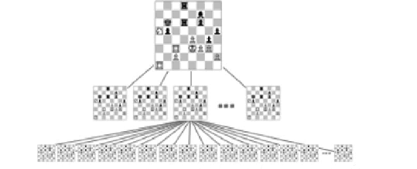
Interactive Proofs are More Efficient! [Lund-Fortnow-Karloff-Nissan90, Shamir90]
Example: Chess

Slide 22
Interactive Proofs are More Efficient! [Lund-Fortnow-Karloff-Nissan90, Shamir90]
correctness of any computation can be proved:
Time to verify
$$≈$$
Space required to do the computation
Interactive
Proof
$$IP=PSPACE$$

Slide 23
Interactive Proofs are More Efficient! [Lund-Fortnow-Karloff-Nissan90, Shamir90]
correctness of any computation can be proved:
Time to verify
$$≈$$
Space required to do the computation
Succinct space succinct interactive proof

Slide 24
Interactive Proofs [Goldwasser-Micali-Rackoff85, Babai85]
All powerful
Efficient
$$x∈L$$
$$P$$
$$V$$
Notes:
I want to emphasize that in this model the (honest) prover can be all powerful. The runtime of the prover is ignored, and the only restriction is on the runtime of the verifier (which is required to be PPT).

Slide 25
Interactive Proofs [Goldwasser-Micali-Rackoff85, Babai85]
$$2^{s^{2}}$$
$$≈s$$
$$P$$
$$V$$

Slide 26
Doubly Efficient Proofs [Goldwasser-K-Rothblum08]
Proofs for any computation:
Prover runtime $≈$computation runtime
Verifier runtime $≈|$input|
Notes:
Doubly efficient proves are ones where the prover is efficient ((ideally, it should be as close as possible to the underlying ``native'' computation) and the verifier is very efficient (almost linear time.
Soundness (as in standard interactive proofs) is against unbounded provers.

Slide 27
Doubly Efficient Proofs [Goldwasser-K-Rothblum08]
Proofs for any computation:
Prover runtime $≈$computation runtime
Verifier runtime $≈|$input|
Theorem:
For every computation represented as a circuit of size $s$ and depth $d,$
there exists a doubly efficient interactive proof for this computation,
where the prover runs in time $≈s$ and the verifier runs in time $≈d$
Notes:
Doubly efficient proves are ones where the prover is efficient ((ideally, it should be as close as possible to the underlying ``native'' computation) and verifier is very efficient (almost linear time), i.e., a muggle.
Soundness (as in standard IP) is against unbounded provers.

Slide 28
Succinct Zero-Knowledge Proofs
Our succinct proofs are interactive!
A succinct zero-knowledge proof that my transaction is valid!
Notes:
As mentioned anyone should be able to come and verify the proofs- whenever they want, without interacting.

Slide 29
Fiat-Shamir Paradigm for Reducing Interaction

Slide 30
The Fiat-Shamir Paradigm [Fiat-Shamir86]
Computationally
sound
(argument)
$$P$$
$$V$$
$$P_{FS}$$
$$V_{FS}$$
$$m_{0}$$
$$h$$
$$r_{1}$$
$$m_{1}$$
$$m_{0},r_{1},m_{1},…,r_{3},m_{3}$$
$$r_{2}$$
$$m_{2}$$
Check that $∀i∈[3]$
$$r_{i}=h\left(m_{0},r_{1},m_{1},…,r_{i−1 },m_{i−1}\right)$$
and that
$(m_{0},r_{1},m_{1},…,r_{3},m_{3})$ is accepting
$$r_{3}$$
$$m_{3}$$

Slide 31
Non-Interactive Arguments
Common Reference String
(such as a hash function)
$$x∈L$$
$$P$$
$$V$$

Slide 32
Succinct doubly-efficient public-coin interactive proof
$$+$$
Fiat-Shamir paradigm
Succinct non-interactive argument
(SNARG)

Slide 33
The Doubly-Efficient IP for bounded depth computations
$$+$$
Fiat-Shamir paradigm
SNARG for bounded depth computations

Slide 34
From Theory to Practice
Hyrax
[WTSTW17]
Zebra
[WHGSW16]
Giraffe
[WJBSTWW17]
Pepper
[SMBW12]
Ginger
[SVPBBW12]
Bulletproof
[BBPWM18]
Ligero
[AHIV17]
libSTARK
[BBHR18]
Pinocchio/libSnark
[PHGR13, BCGTV13]
Buffet
[WSRBW15]
Pantry
[BFRSBW13]
Zaatar
[SBVBPW13]
Proof Carrying Data
[BCTV14, CTV15]
Scalable Zero Knowledge
[BCTZ14]
Notes:
Eli Ben-Sasson and Iddo Bentov and Yinon Horesh and Michael Riabzev
Bulletproof: Bootle, Dan Boneh, Andrew Poelstra, Pieter Wuille, Greg Maxwell.

Slide 35
Eliminating Depth Restriction
Idea: Convert computation to low-depth circuit!
$$out$$
$$c_{T}$$
1
.
.
.
$$x$$
$$c_{1}$$
$$c_{T}$$
$$out$$
$$c_{2}$$
Run the doubly efficient IP
on squashed circuit!
$$c_{1}$$
$$x$$
$$x1$$
$$x2$$
$$x3$$

Slide 36
Eliminating Depth Restriction
Idea: Convert computation to low-depth circuit!
$$out$$
$$c_{T}$$
1
.
.
.
$$x$$
$$c_{1}$$
$$c_{T}$$
$$out$$
$$c_{2}$$
$$c_{1}$$
Unknown to verifier!
$$x$$
$$x1$$
$$x2$$
$$x3$$

Slide 37
Eliminating Depth Restriction
Idea: Convert computation to low-depth circuit!
$$out$$
$$c_{T}$$
1
.
.
.
$$x$$
$$c_{1}$$
$$c_{T}$$
$$out$$
$$c_{2}$$
Prover commits to $\left(x,c_{1},…,c_{T},out\right)$
Using a cryptographic commitment
$$c_{1}$$
$$x$$
$$x1$$
$$x2$$
$$x3$$

Slide 38
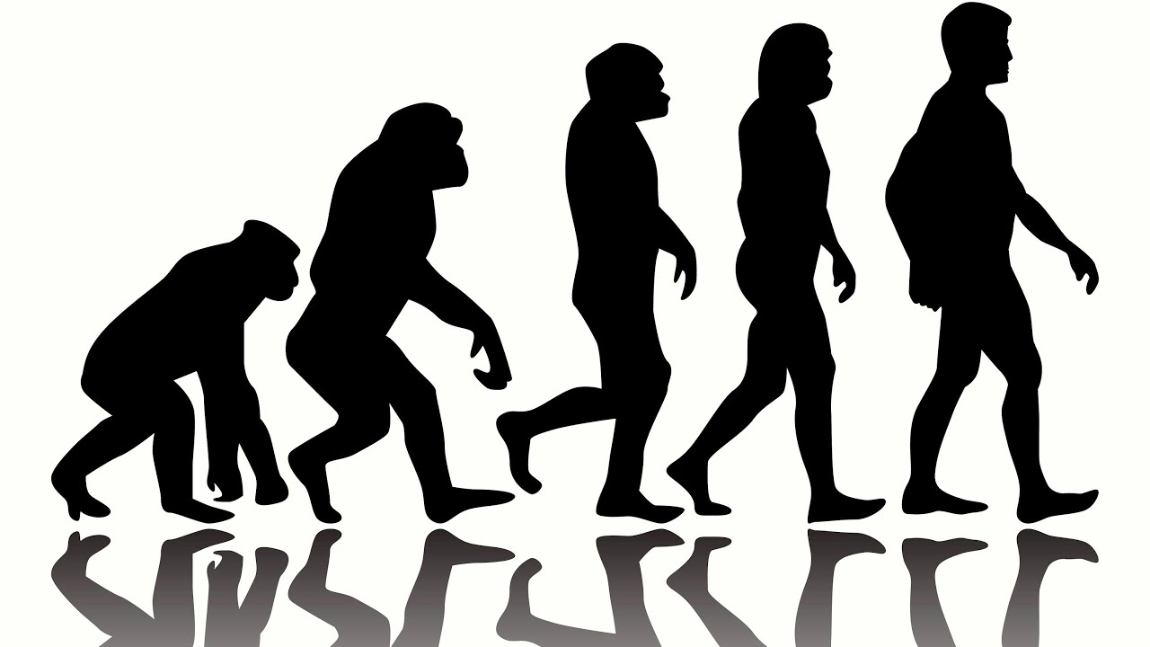

Slide 39
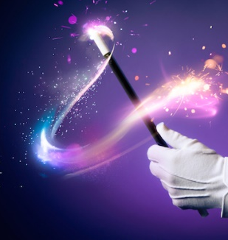
Classical proofs
(Zero-knowledge)
Interactive proofs
multi-prover
interactive proofs
Probabilistically
checkable proofs
Interactive PCP/
Interactive Oracle Proofs

